Slide 1


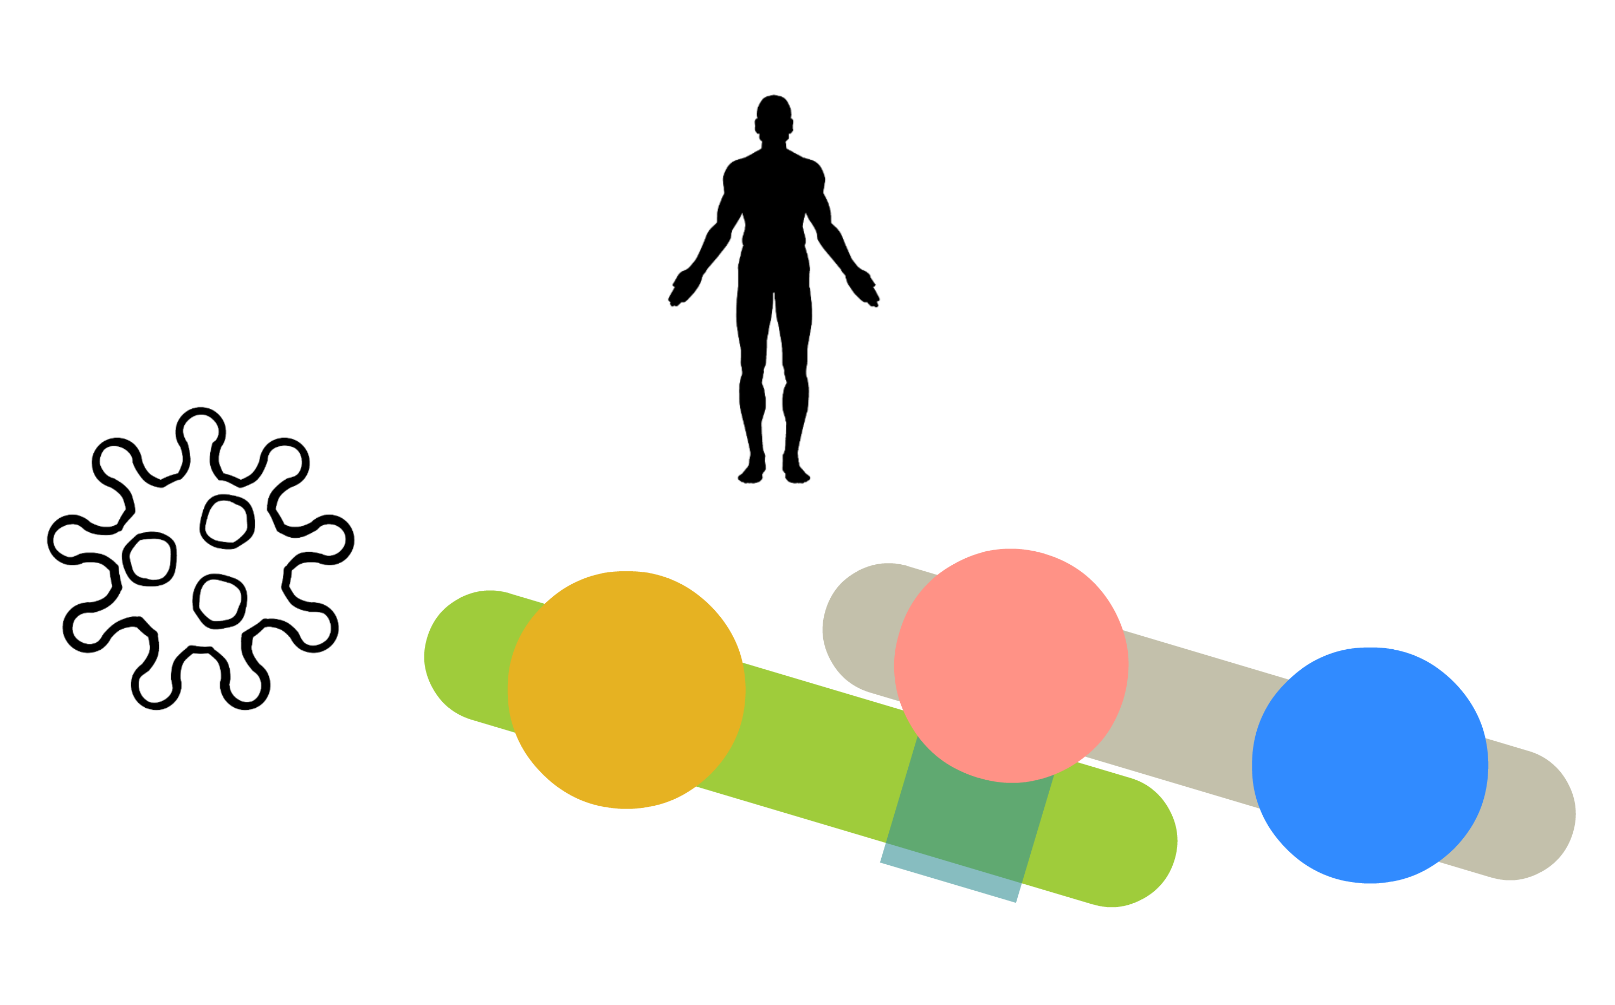
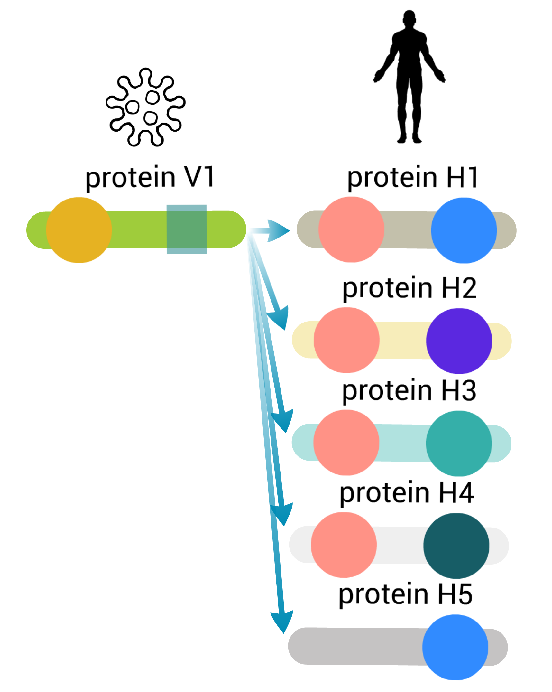
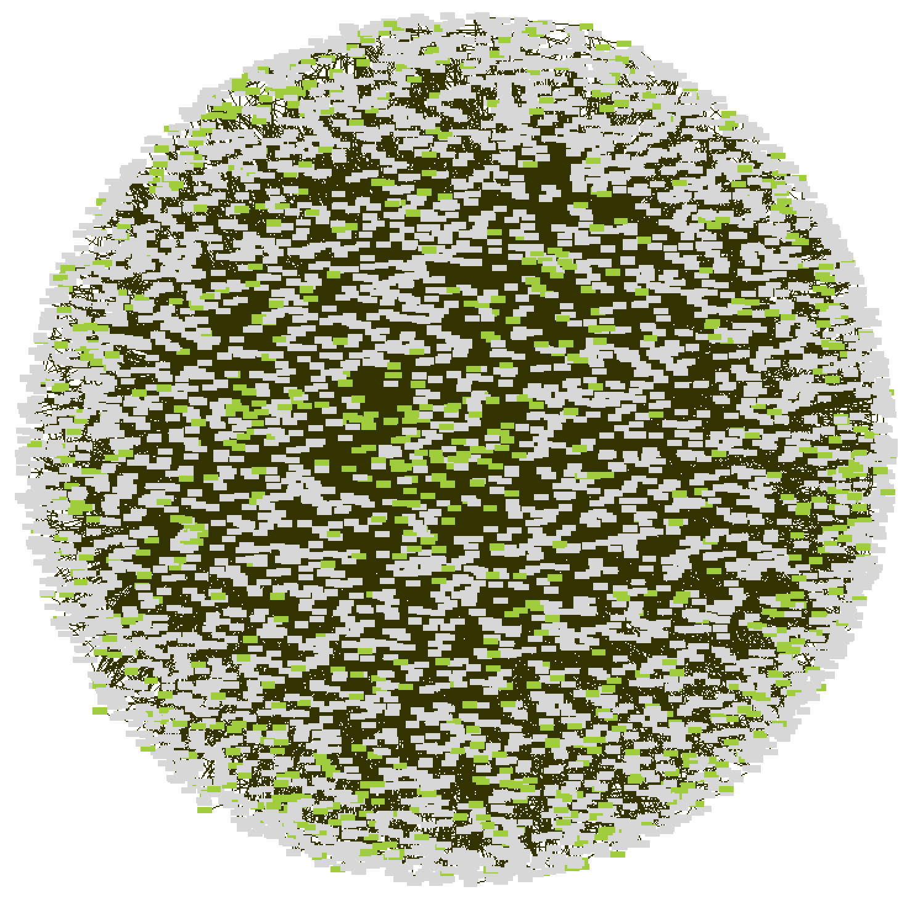

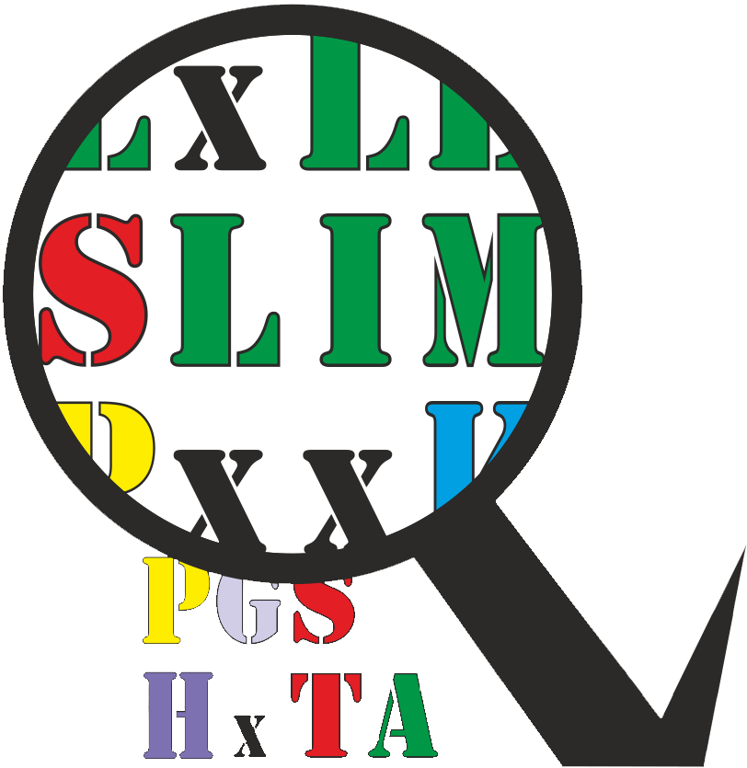
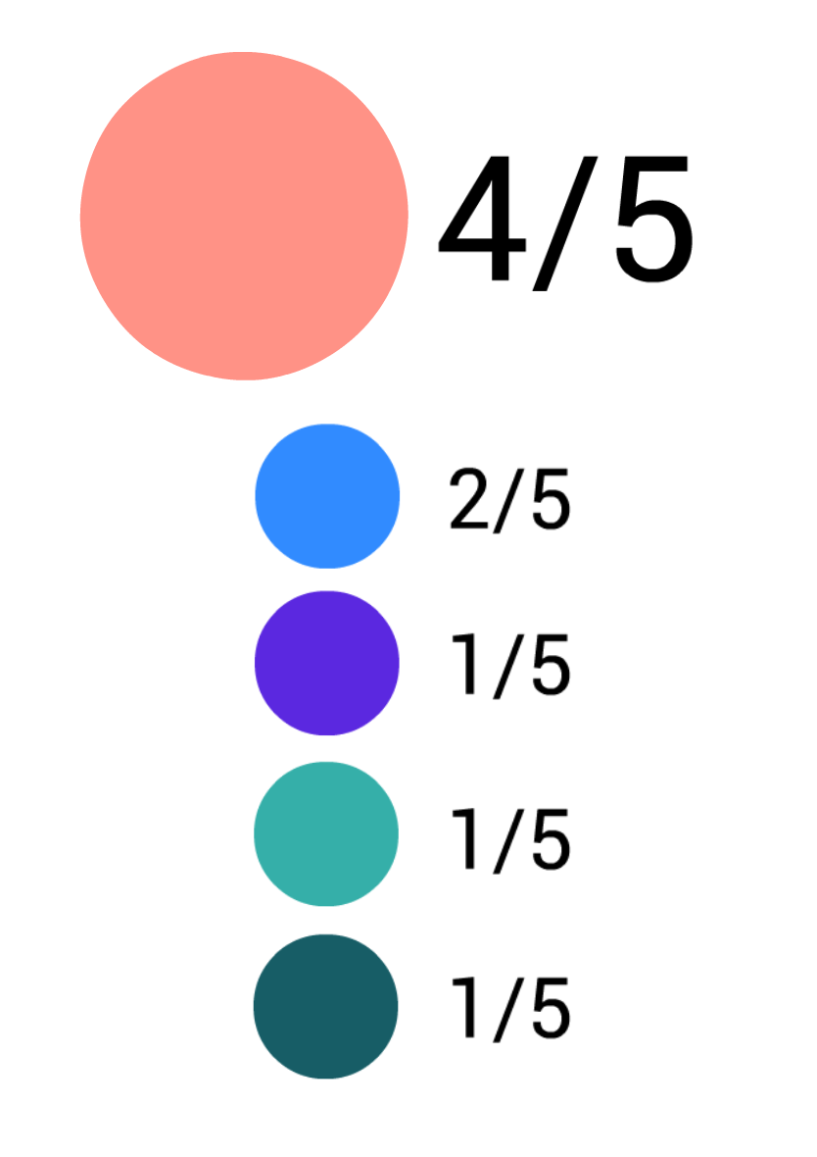
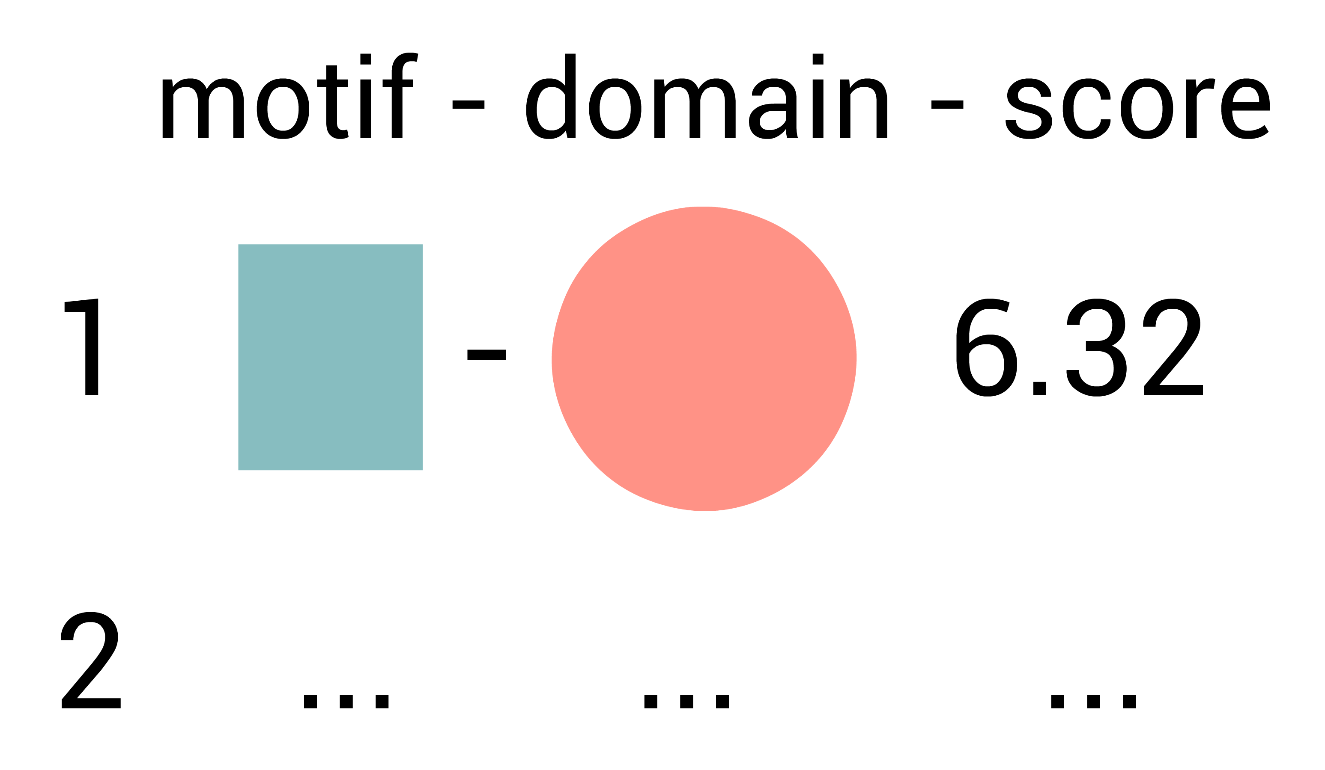
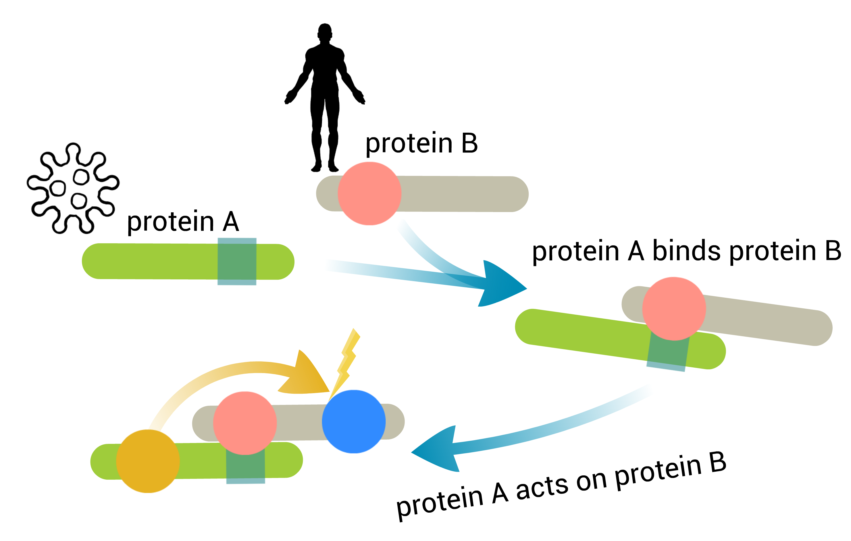
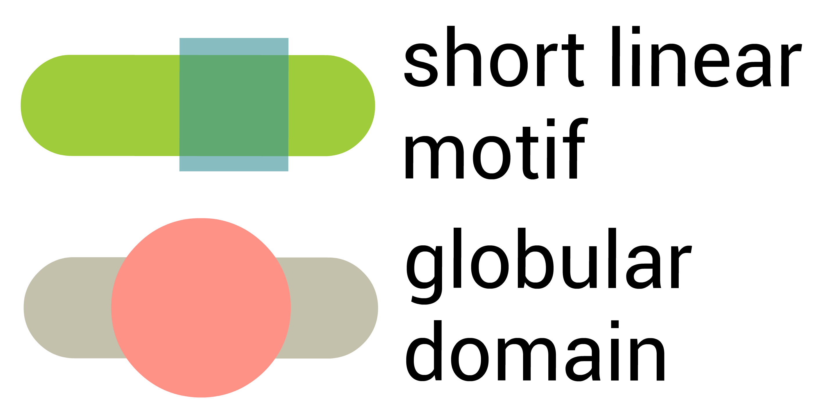
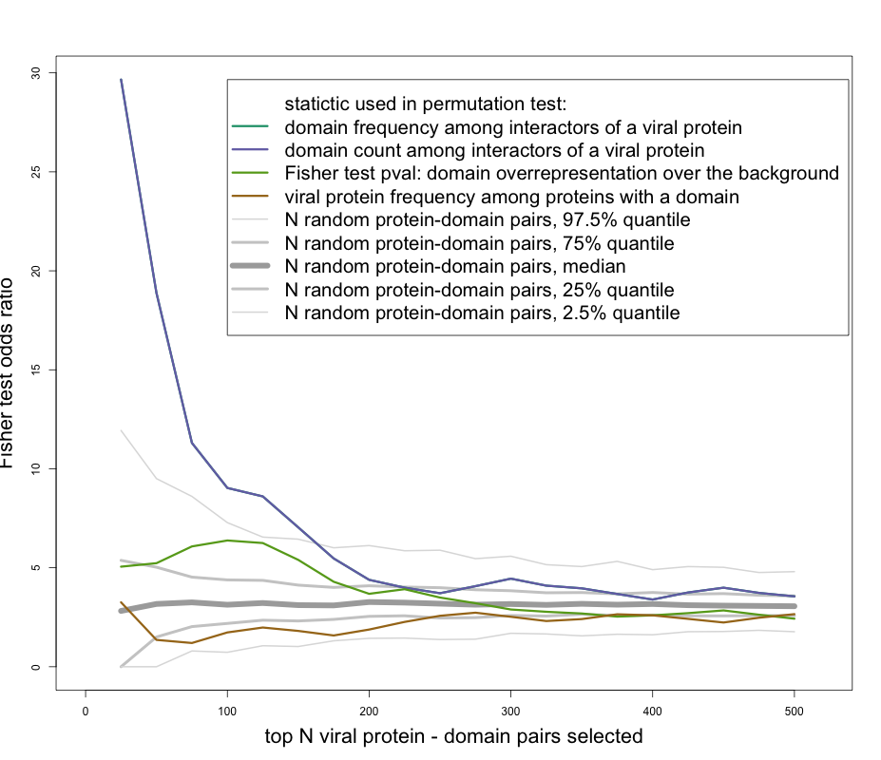

Identifying novel functional linear motifs using host-viral protein interactions and the principle of convergent evolution
Vitalii Kleshchevnikov, Evangelia Petsalaki
EMBL-EBI, how do I call the group?
Workflow
Dataset
1
We obtain protein
interaction data from
1
Experimentally derived protein-protein interaction data:
human-human vs viral-human
Globular
domains
2
We use to identify
known globular domains
2
Viral proteins tend to have more human interacting partners than human proteins have viral interacting partners.
Viral-interacting human proteins have more known interacting partners than average human proteins.
We use full human-human network for motif search while restricting the search space using interactions from human-viral network
Linear
motif
motif-domain
pair
3
We estimate which
domains are likely to
mediate interaction
4
We take interacting partners of
every protein that contains these
domains and use QSLIMFinder to discover linear motifs de-novo
5
Resulting domain-motif pairs can be compared to known and tested using phage display
2
Domain features
Scanning protein interaction network using signatures from InterPro member databases give us XXX protein-domain pairs in the full human-human network (XX, in the viral-human network)
Linear motif mediated protein interactions
short linear motifs:
3-15 amino acids in length
3-5 defined positions
allow inducible recruitment
extensively involved in cell signaling
hard to identify functional motifs
Future directions
Results
extensively exploited by viruses
evolve quickly and enable rewiring of host-pathogen interactions
Identifying linear motifs de-novo using QSLIMFinder
Additionally limit search space using binding region annotations
Comparing viral proteins to other groups of proteins by their ability to identify known domains and motifs
Annotating potential meaning of viral-human domain-motif interaction
Summary
To estimate which domains in human proteins are likely to mediate interaction we have calculated different statistics characterising how often specific domains appear among interacting partners of viral proteins. Next, to estimate how likely these values are to be observed by chance we have permuted protein interactions along viral – human interface. We have analysed if the top domain hits are enriched in domains known to bind linear motifs (ELM database) by performing one-sided Fisher test
Viral-host interactions rely extensively on linear motif mediated interactions
Rich viral-human protein interaction data can allow identifying domain motif pairs
Domains in human proteins that are likely to mediate human-viral interactions are enriched in domains known to bind linear motifs
References:
IMEx consortium databases such as IntAct, MINT, DIP, BHF-UCL, MPIDB, MatrixDB, HPIDb, I2D-IMEx, InnateDB-IMEx, MolCon, UniProt, MBInfo are currently integrated into IntAct [1].
1. Orchard S, Ammari M, Aranda B, et al. The MIntAct project—IntAct as a common curation platform for 11 molecular interaction databases. Nucleic Acids Research. 2014;42(Database issue):D358-D363.
2. Orchard S, Kerrien S, Abbani S, Aranda B, Bhate J, Bidwell S, et al. Protein interaction data curation: the International Molecular Exchange (IMEx) consortium. Nature Meth. 2012;9:345–350.
3. Vincent M, Schnell S. A collection of intrinsic disorder characterizations from eukaryotic proteomes. Scientific Data. 2016;3:160045.
4. Marc Carlson (2017). GO.db: A set of annotation maps describing the entire Gene Ontology. R package version 3.4.1.
5. Guangchuang Yu, Li-Gen Wang, Yanyan Han and Qing-Yu He. clusterProfiler: an R package for comparing biological themes among gene clusters. OMICS: A Journal of Integrative Biology 2012, 16(5):284-287
6. Rolland T, Taşan M, Charloteaux B, et al. A proteome-scale map of the human interactome network. Cell. 2014;159(5):1212-1226. 7. Hein MY, Hubner NC, Poser I, et al. A human interactome in three quantitative dimensions organized by stoichiometries and abundances. Cell. 2015;163:712–723.

Slide 2
v H

